Slide 1
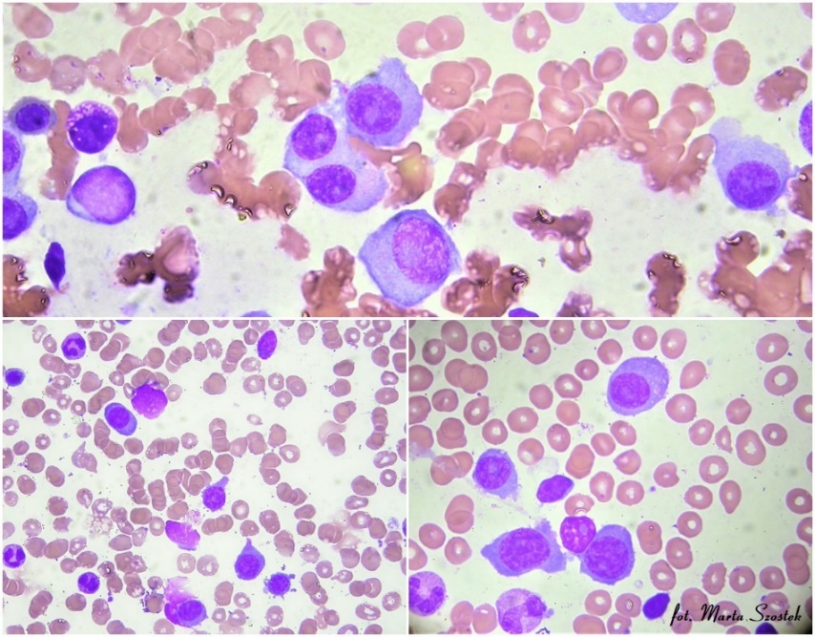
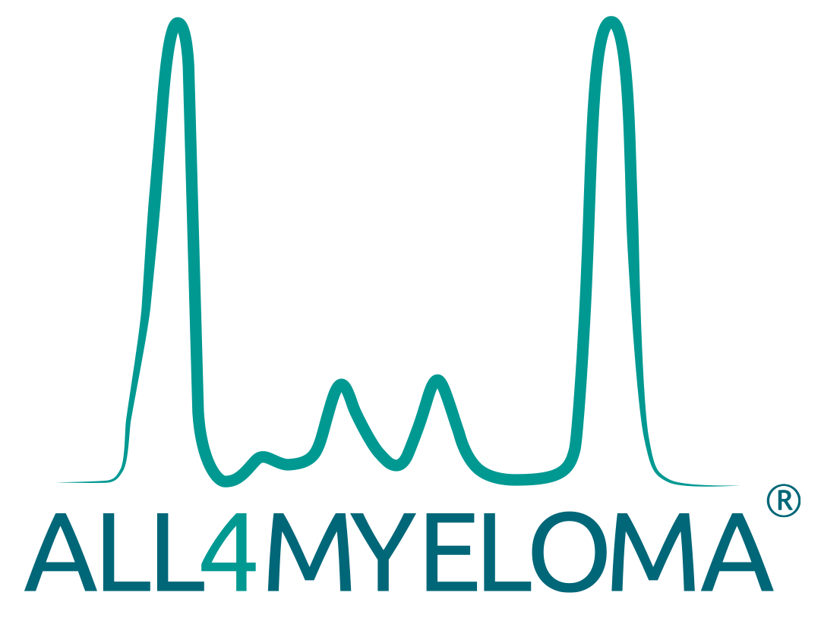


PLASMA CELL
LEUKEMIA – what is new in 2021?
Artur Jurczyszyn, MD PhD Professor at the Plasma Cell Dyscrasia Center Jagiellonian University, Kraków, Poland

Slide 2
Disclosures for ARTUR JURCZYSZYN, MD
Research Support/P.I.
No relevant conflicts of interest to declare
Employee
No relevant conflicts of interest to declare
Consultant
No relevant conflicts of interest to declare
Major Stockholder
No relevant conflicts of interest to declare
Speakers Bureau
No relevant conflicts of interest to declare
Honoraria
Amgen, Celgene, Janssen-Cillag, Takeda, Karyopharm
Scientific Advisory Board
Amgen, Celgene, Karyopharm, Janssen-Cillag

Slide 3
What is new in plasma cell leukemia in 2021?
Agenda
Diagnosis and prognosis
Wind of change
Therapy
What happend in the last two years?
The latest clinical practice guidelines
Actual algorytms of the treatment plasma cell leukemia
Future
Perspectives - what you need to effectively diagnose and treat plasma cell leukemia

Slide 4
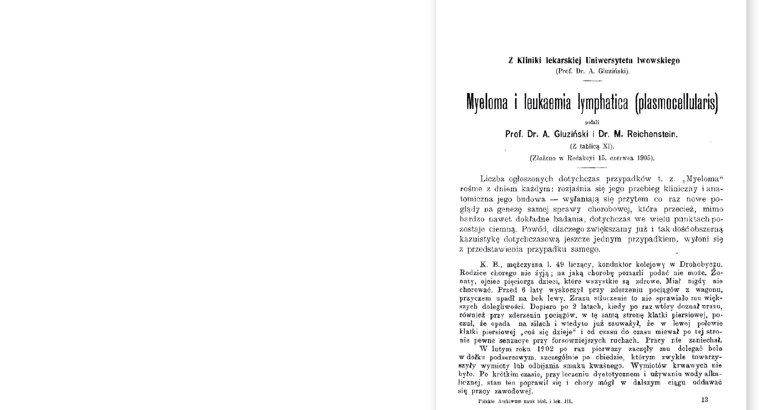
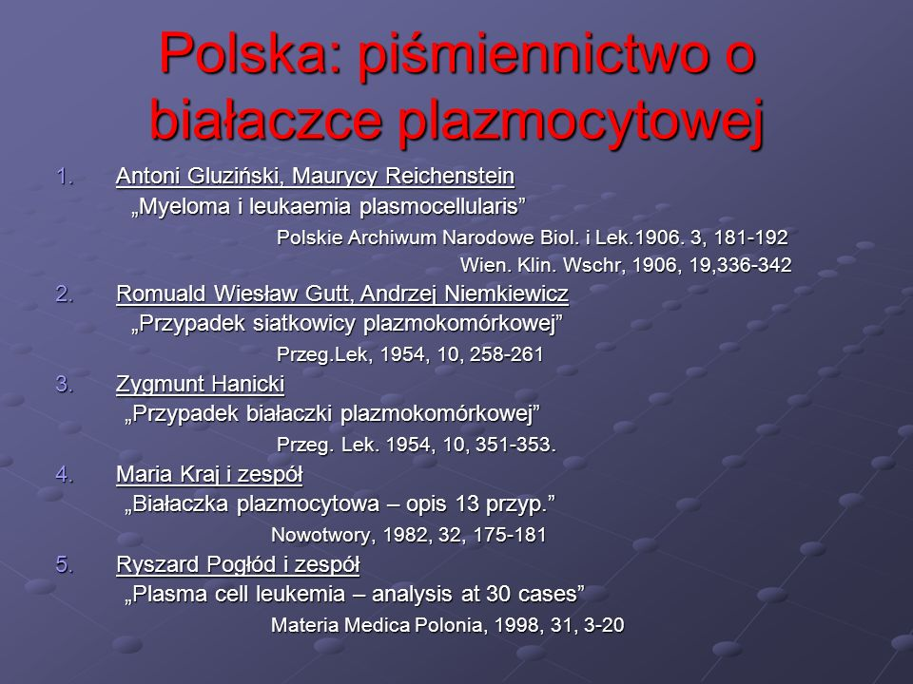
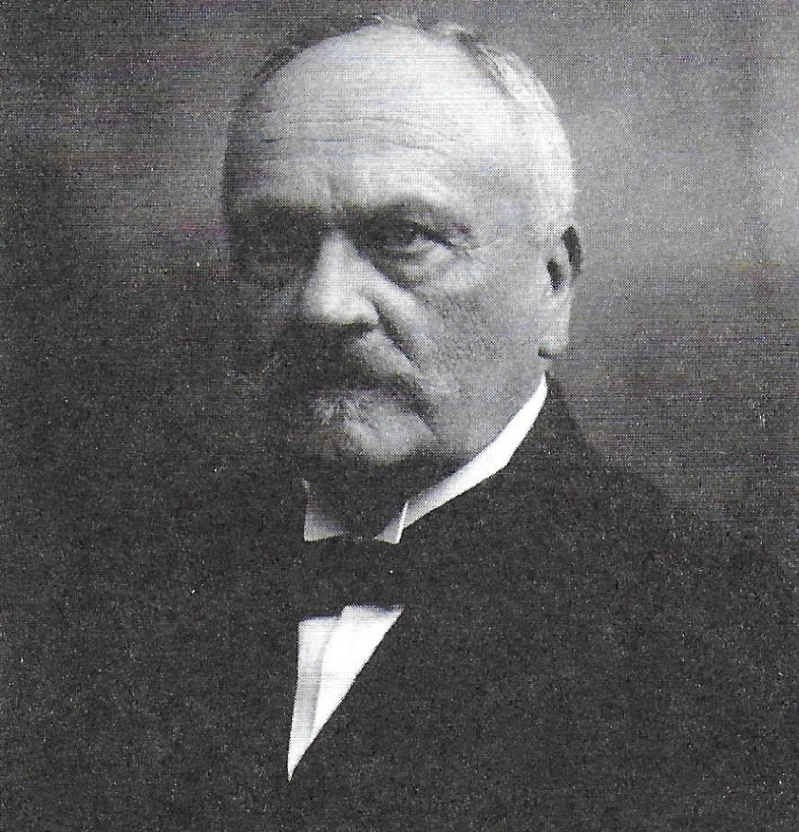
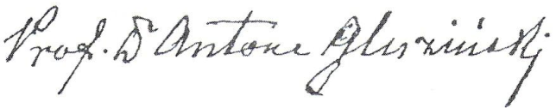
Władysław Antoni Gluziński (born 18 MAY 1856 in Włocławek, died 10 APRIL 1935 in Warsaw) – polish physician, professor, internist, pathologist and clinician, teacher.

Slide 5
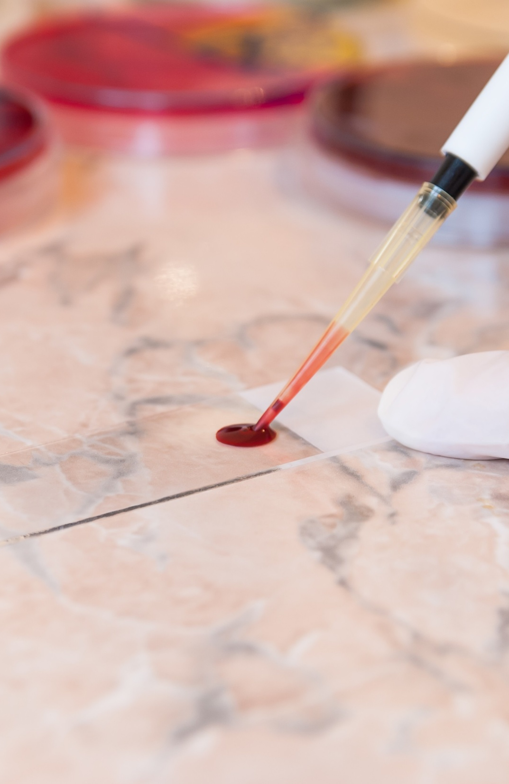
Diagnosis
Current diagnostic criteria and cytogenetic risk
Should we change the current diagnosic crietria?

Slide 6
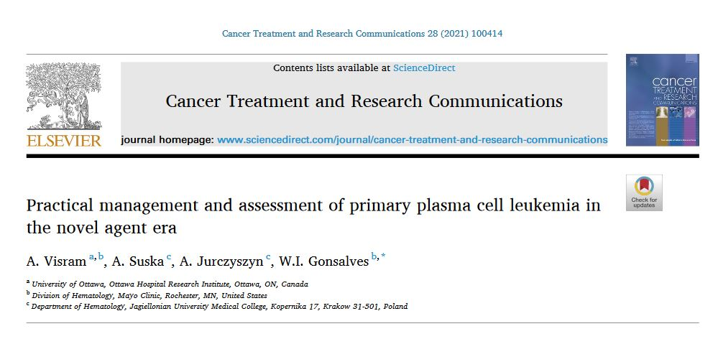
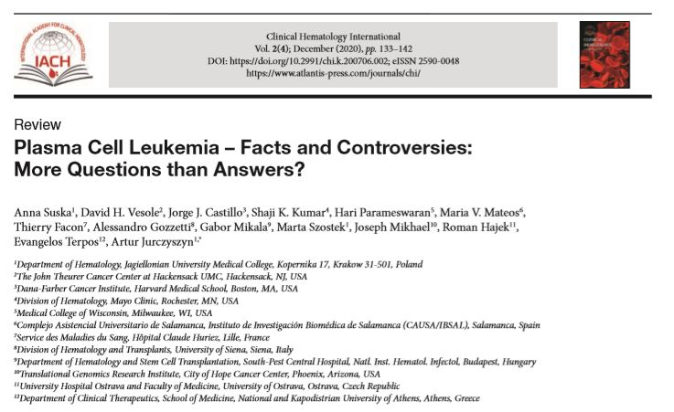

Slide 7
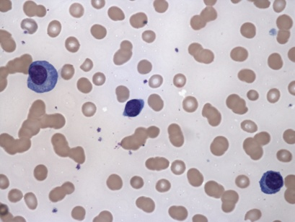
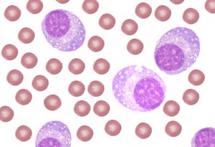
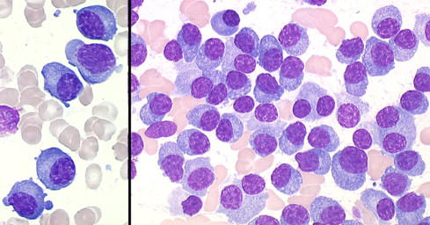
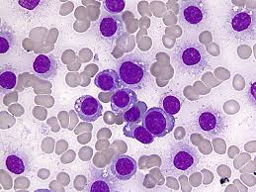
Diagnostic criteria
Plasma cell leukemia (PCL) is rare and agressive disease where you will find neoplasmatic proliferation of plasma cells (PCs)
Diagnostic criteria are based on the number PCs:
            Absolute number >2 x 10⁹/l
                OR
            >20% total leukocyte count
PLC could develop and start:
            de novo (primary PCL, pPCL);
            60% all cases
            During progression multiple myeloma (secondary PCL, sPCL); 40% all cases
>2 x 10⁹/l
>20%
Jimenez-Zepeda VH, Dominguez VJ. Ann Hematol. 2016;85:263–267.
Bladé J, Kyle RA. Hematol Oncol Clin North Am. 1999;13:1259-1272.

Slide 8
Criticism of diagnostic criteria
Instead of two criteria, isn’t only one enough to diagnose the disease?
In practice, many clinical trial based on only one of two criteria.
Patients with poor bone marrow reserve have baseline leukopenia and may not meet absolute criteria (but may fulfill percentage criteria)
A low proportion of PCs can be detected in peripheral blood in patients within the entire spectrum of plasma cell dyscrasias (MM, SMM, MGUS), and it can change with time
Poor prognosis deserves a prompt identification of these patients to establish the most effective treatment

Slide 9
At the dawn of a new definition
% of PCs
in peripheral blood
Patients with MM or PCL
Control
vs
Data from the Mayo Clinic
(n = 176)
Granell M et al. Haematologica 2017;102(6):1099-1104.
Ravi P et al. Blood Cancer Journal 2018;8(12):116.
de Larrea CF et al., in press
Data from 5 Catalonian
hospitals
(n = 482)
Patients with diagnosis
but without cPCs
in peripheral blood
(n = 9724)

Slide 10
Overall survival depending on the percentage of cPCs
Result of the comparison
p < 0.001
Data from the Mayo Clinic
(n = 176)
p < 0.001
Data from 5 Catalonian
hospitals
(n = 482)
Granell M et al. Haematologica 2017;102(6):1099-1104.
Ravi P et al. Blood Cancer Journal 2018;8(12):116.
de Larrea CF et al., in press

Slide 11
New definitione of plasma cel leukemia
3x
Patients with ≥5% cPCs have a similar adverse prognosis as the previously defined PCL
IMWG will propose change of the diagnostic criteria.
will increase the number
of patients diagnosed
with PCL
de Larrea CF et al., in press

Slide 12
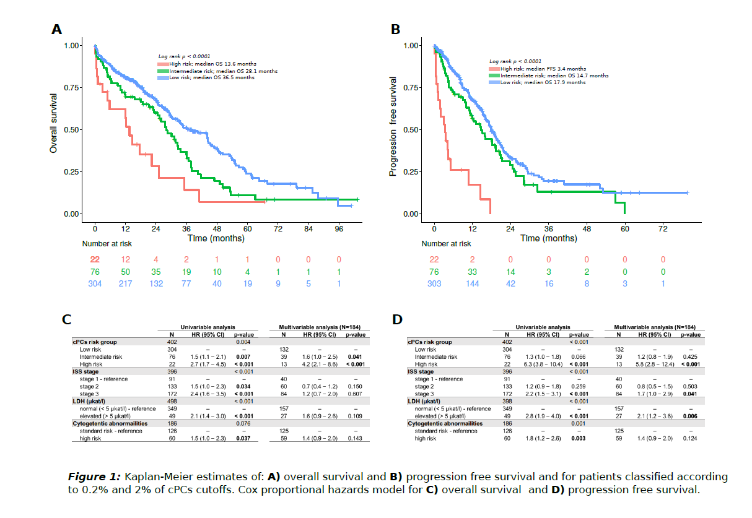
TITLE: Circulating Plasma Cells Are the Most Powerful Prognostic Marker in Transplant Ineligible Multiple Myeloma with 2% As a New Cut-Off for Primary Plasma Cell Leukemia
Session Name: 652. Multiple Myeloma and Plasma cell Dyscrasias: Clinical and Epidemiological: Reoptimizing Standards and Redefining Approaches
Session Date: Sunday, December 12, 2021
Session Time: 4:30 PM - 6:00 PM
Presentation Time: 5:45 PM
Room: Georgia World Congress Center, Hall A1
We defined 2% of cPCs as a new cut-off for ultra high risk myeloma resembling behavior of primary PCL. We propose this 2% cut-off for redefinition of pPCL criteria that warrants further investigation in prospective setting.

Slide 13
Prognosis
Cytogenetic burden of plasma cel leukemia
Survival time in primary and secondary plasma leukemia - yesterday and today
Prognosis. How was the prognostic index created and how to use it in practice?

Slide 14
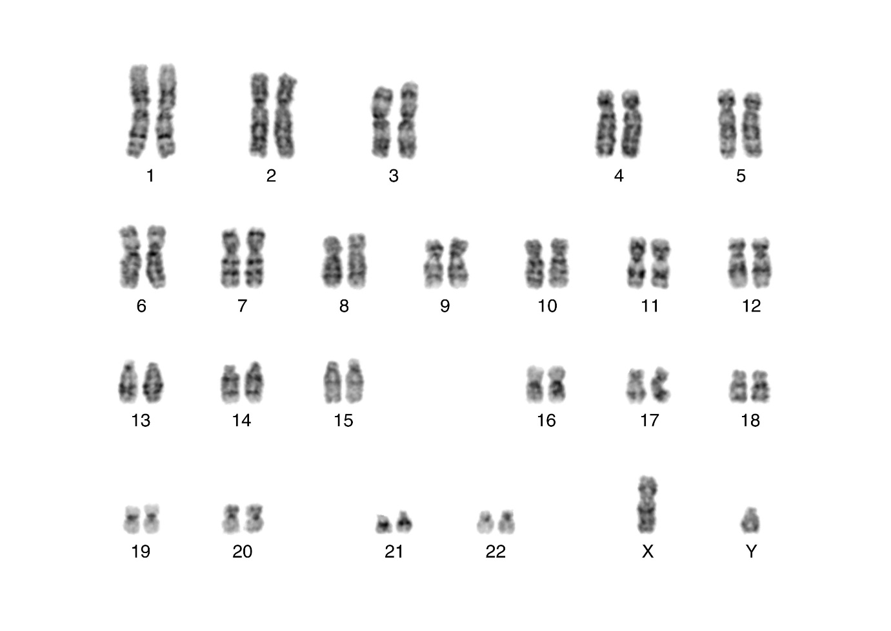
Cytogenetic risk
amp(1q)
del(1p)
Dysregulation of MYC
t(11;14) CCND1
Translocation of IgH
del(17p)
Biallelic loss of TP53
Gowin K et al., Leukemia Research 2021; 111:106687.

Slide 15
Cytogenetic risk
The molecular basis of PCL is poorly known. Cytogenetic studies have shown that plasma cells (PCs) in pPCL have a whole range of cytogenetic disorders commonly considered to worsen survival prognosis.
Cytogenitc | Garcia-Sanz et al., 1999 | Dimopoulos et al., 1994 | Tiedemann et al., 2008 | Pagano et al., 2011 | Avet-Loiseau et al., 2001 | Chiecchio et al., 2009
Hiperdiploid form |  | 41% | 60% | 12,2% | 47% | 41,6%
Hipodiploid form |  |  | 0% | 4,9% | 8,8% | 33,3%
Complex karyotype |  | 92% | 54,5% | 34,2% | 58,8% | 66,7%
del(13q14) lub monosomia | 84% | 50% | 85% | 19% | 68% | 58%
del(17p13) |  |  | 50% | 7,3% | 11,8% | 25%
t(11;14) |  |  | 71% | 19,5% | 33% | 42%
t(4;14) |  |  | 0% | 0% | 12% | 8,3%
t(14;16) |  |  | 0% | 0% | 16% | 25%
de Larrea CF et al., Leukemia 2013; 27:780–791.

Slide 16
How pPCL
differs from MM?
 | pPCL | MM
Median Age | 52-65 | 65-70
Cytopenia - anemia - thrombocytopenia | 54-100% 48-100% | 40-73% 3-5%
Lytic Lesion | 35-64% | 60-67%
Extramedullary Disease - liver - spleen - lymph nodes | 23-56% 18-53% 3-12% | 1-4% 1-2% 1%
M- Component - IgG - IgA - Light Chain - Non secretory | 12-54% 4-25% 20-44% 4-18% | 52-64% 21-23% 9-18% 1-7%
High LDH High B2m | 37-63% 50-100% | ≈13% ≈25%
Fernandez de Larrea et al. Leukemia 2013; Kyle et al, Mayo Clin proc 2003, Riccardi et al, Eur J Cancer 1991, Paulumbo et al, JCO 2015

Slide 17
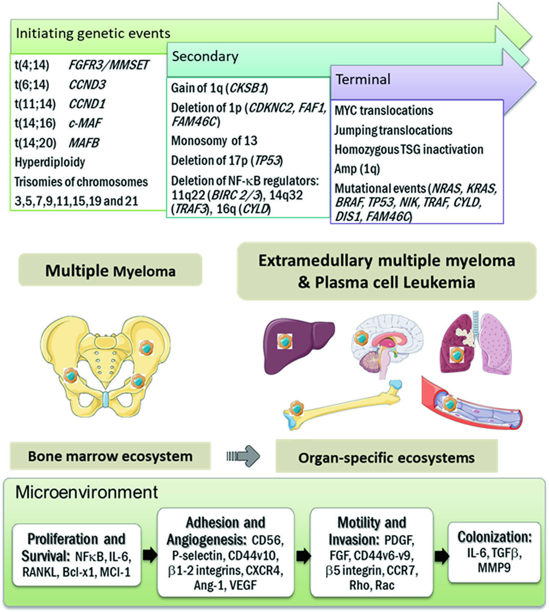
Pathogenesis of EMM and PCL
PC EGRESS TO ECOSYSTEM OUTSIDE THE BONE MARROW
Buthani M et al Leukemia (2020) 34:1–20

Slide 18
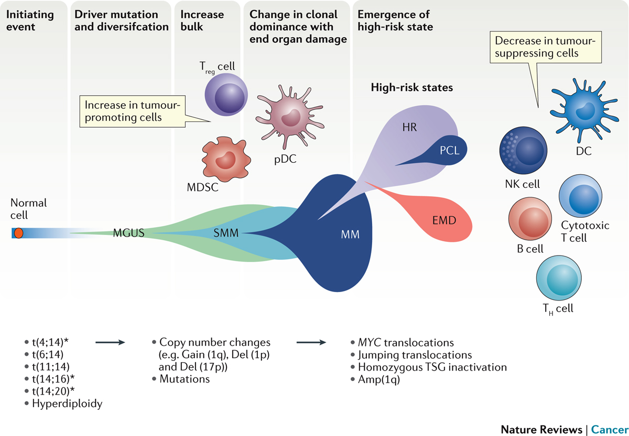
The interaction between genetic drivers and microenvironment changes drives high-risk disease states
Pawlyn C, Morgan G. Nature revievs Cancer 2017

Slide 19
BIOLOGY of pPCL: Immunophenotype
Myeloma cells are strongly dependent on the bone marrow microenviroment which regulates their prolifertion and survival
≠
In pPCL malignant plasma cells tend to egress to the peripheral blood stream
DIFFERENT PATTERNS OF EXPRESSION ADHESION MOLECULES IN MM and PCL CELLS
ROLE OF CD56/NCAM
Higher CD56 expression: anchorage of plasma cells to bone marrow stroma
Lower CD56 expression: migration to extramedullary sites
Pellat-Deceunync et al, Leukemia 1998

Slide 20
pPCL and EMM: how they differs from MM
Biology
 | pPCL | EMM (relapse/diagnosis) | MM
Immunophenotype
CD38 | 100% | Positive/ reports of negative relapses vs MM | 100%
CD20 | 50% | NA | 17%
CD56 | 45% | 58%/reduced/unchanged vs MM | 70%
CD117 | 0% | 0.1% | 43%
FISH abnormalities
del(13q) | 57-86% | 59% | ≈50%
del(17p) | 20-50% | 35% | ≈10%
t(11;14) | 25-65% | 14% | ≈15%
1q gain | 46-67% | 54% | ≈30-40%
t(4;14) | 29% | 23% | ≈13%
Mutations
p53 | 25% | Inceased vs MM | 3%
Garcia-Sanz et al, Blood 1999, Van de Donk, Blood 2012, Buthani M et al Leukemia (2020) 34:1–20; Tembhare P et al Leuk Lymphoma 2012, Rasche L et al Nature 2017

Slide 21
pPCL and EMM vs MM: Staging System
MM: Standard Risk factors and R-ISS
pPCL ISS III 63-80%
EMM ISS III 16%
pPCL del17 up to 50%
EMM del17 up to 35%
pPCL high LDH up to 63%
EMM high LDH not reported
ARE THESE PROGNOSTIC FEATURES OF ADDED VALUE IN pPCL and/or EMM???

Slide 22
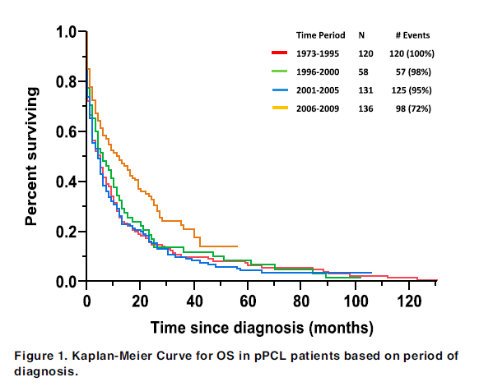
Survival in primary PCL
pPCL has an aggressive clinical presentation and aggressive clinical course; worse outcome when compared to MM
Early mortality due to aggressive presentation with severe complications
A Dinmohamed, EHA 2018
Gonsalves Blood 2014 ; Dinmohamed, EHA 2018

Slide 23
Survival time in the past decades
Pagano L. et al. 2011
Peijing Q. et al. 2009
pPCL
Tiedemann RE et al. 2008
Colović M, et al. 2008
García-Sanz R. et al. 1999
Dimopoulos MA et al., 1994
Noel & Kyle, 1989
1 | 2 | 3 | 4 | 5 | 6 | 7 | 8 | 9 | 10 | 11 | 12 | 13 | 14
Noel & Kyle, 1989
Median survival time [months]
Point size = number of patients = 25
Distance from the axis = later publication year
sPCL
Tiedemann RE et al. 2008
Pagano L. et al. 2011
Noel P, Kyle RA. Am J Med. 1987;83:1062-1068. US
Dimopoulos MA et al. Br J Haematol. 1994;88:754-759.
García-Sanz R, et al. Blood. 1999;93:1032-1037.
Tiedemann RE et al. Leukemia. 2008;22:1044-1052.
Colović M, et al. Med Oncol. 2008;25:154-160.
Peijing Q. et al. Acta Haematol. 2009;121:47-51.
Pagano L. et al. Ann Oncol. 2011;22:1628-1635.

Slide 24
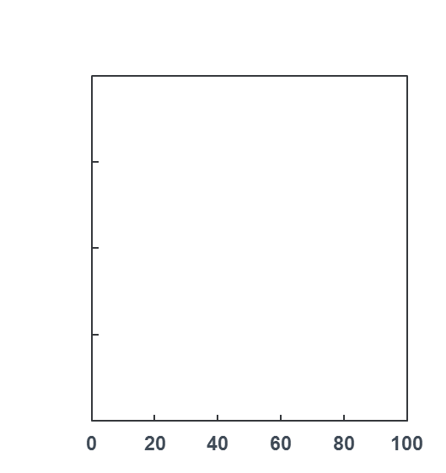
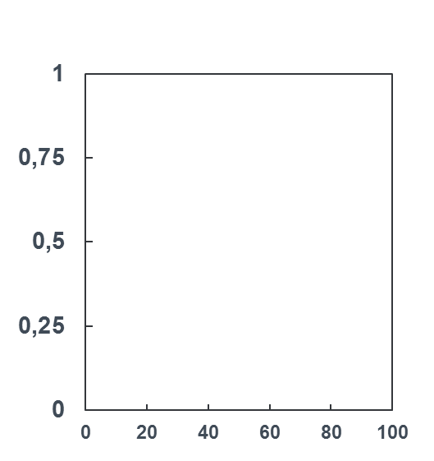
Survival time
now
PCL in the era of new drugs
pPLC
sPLC
Retrospective analysis covering medical documentation from 34 centers from 3 continents
All patients were diagnosed with PCL in 2006-2016:
pPCL, n = 117, (71% diagnosed in 2011-2016)
sPCL, n = 101, (85% dignosed in 2011-2016)
23
4,3
Probability of survival
Months from diagnosis
Months from diagnosis
OS = 23 mies. (95% CI: 15-34)
OS = 4,2 monts (95% CI: 1,3-8,0)
Survival time ≈ doubled since last decade
Jurczyszyn A. et al. Br J Haematol. 2018;180:831-839.
Jurczyszyn A. et al. Leuk Lymphoma. 2018;2:1-6.

Slide 25

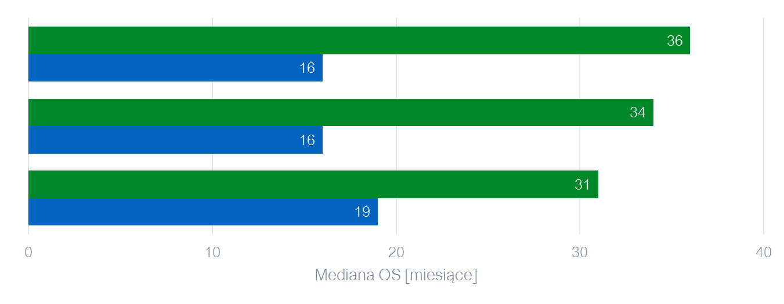
Important factors affecting survival
pPLC
HR (95% CI)
age
<60 lat
≥60 lat
2.3 (1,4-3,8)
PLT
>100x10⁹/l
≤100z10⁹/l
2,1 (1,3-3,4)
PCs
<20x10⁹/l
≥20x10⁹/l
1,9 (1,0-3,7)
sPLC
PLT
>100x10⁹/l
4,0 (2,0-8,0)
≤100z10⁹/l
Jurczyszyn A. et al. Br J Haematol. 2018;180:831-839.
Jurczyszyn A. et al. Leuk Lymphoma. 2018;2:1-6.

Slide 26
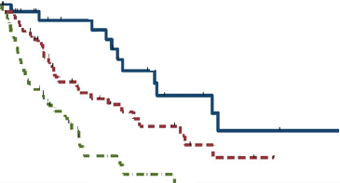
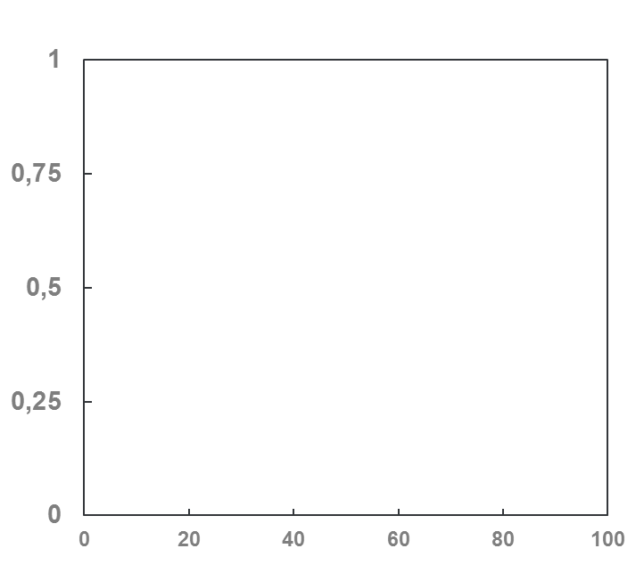
Prognostic index
Independent risk factors of inferiority OS:
age ≥ 60 years old
PLT ≤ 100z10⁹/l
PCs ≥ 20x10⁹/l
were used to develop the pPCL prognostic index (PCL-PI) by assigning 1 point to an adverse prognostic factor. The PCL-PI value is between 0 and 3.
PCL-PI = 0, (n=26),
mediana OS = 46 months
PCL-PI = 1, (n=51),
mediana OS = 17 months.
PCL-PI = 2-3, (n=51),
mediana OS = 12 months
PCL-PI: 0 vs. 1, HR: 2.2 (95% CI: 1.1 – 4.4), p = 0.03
PCL-PI: 0 vs. 2-3, HR: 5.8 (95% CI: 2.8 – 12.0), p<0.001
Jurczyszyn A. et al. Br J Haematol. 2018;180:831-839.

Slide 27

Prognostic index pPCL-PI in clinical practice
First, using the 3-variable pPCL-PI, we were able to identify a subset
of patients who may particularly benefit from more intensive therapy.
Second, all three variables included in the index can be easily determined at the time of pPCL diagnosis, in comparison to PC immunophenotype or cytogenetic abnormalities, especially in the community.
Finally, all these observations derive from a large series of 117 patients from three continents, minimizing the bias of ethnic background of the study subjects
Jurczyszyn A. et al. Br J Haematol. 2018;180:831-839.

Slide 28
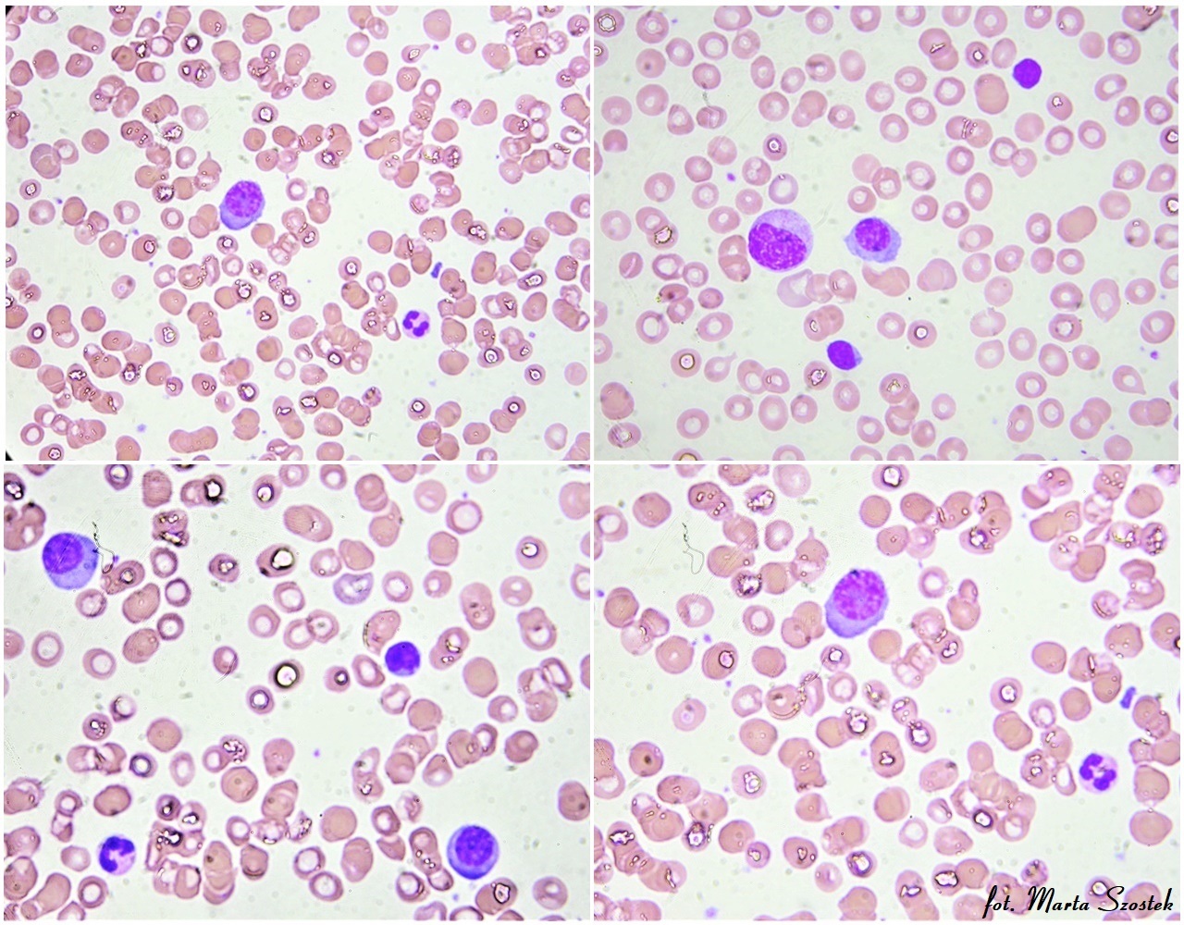
Blood smear – plasma cells

Slide 29

Treatment
Real clinical practice as the main source of knowledge about the effectiveness of treatment
Therapeutic regimens that prolong PCL survival - a review of recent reports

Slide 30
Clinical Trial
EMN12/ HOVON 129 PCL
AGE
18-65 years old
AGE
≥66 years old
  Carfilzomib and lenalidomide-based treatment in younger and older patients with newly diagnosed pPCL.
  Lenalidomide with carfilzomib and dexamethasone (CRd) is a combination with high efficacy and a low risk of polyneuropathy
  Carfilzomib and lenalidomide will be used for consolidation and maintenance after transplantation in younger patients, and as maintenance for elderly patients after induction therapy.
  Patient enrollment finshed.
INDUCTION
4xCRd
4xCRd
PD
PD
Cyklofosfamid+ G-CSF+
Mobilisation STEM CELLS
4xCRd
NO transplanation
PD
PD
4xCRd
PD
INTENSIFICATION
HDM+ Auto-SCT
NO DONOR
DONOR
HDM+ Auto-SCT
PD, SD
Consolidation
2xCRd
PR, VGPR, (s)CR
PD
Brak możliwości
4xCRd
RIC Allo-SCT
(allo-SCT from sibling donor or MUD donor)
PD
PD
MAINTANCE
Carfilzomib 27 mg/m²: starting 2 months post-allo-SCT for 6 months; followed by lenalidomide plus carfilzomib 27 mg/m² until progression
Carfilzomibe and lenalidomide
Therapy till progression
CRd-karfilizomib, lenalomid, deksametazon; G-CSF- granulocyte-colony stimulating factor; HDM- high-dose melphalan; RIC- reduced-intensity conditioning regimen; PD- progression disease; SD- stable disease; PR- partial response; VGPR-very good partial; (s)CR-stringend complete response
Protocol EMN12/ HOVON 129 PCL

Slide 31
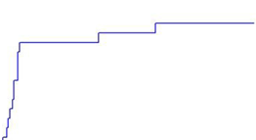
EMN12/ HOVON 129 PCL interim analysis
Response to treatment
Study enrolled 30 patients.
Response to treatment data come from 15 males aged <65 years old:
  14 pts. received 4 cycles of CRD,
  1 died after 3rd cycle
3rd (20%) i 4th (25%) grade toxicity was present mainly at the first cycle of treatment
CRd provided efficient and rapid disease control, which is essential
to prevent early mortality,
N = 14
Time to the first serious
adverse event
Skumulowany odsetek
N = 21
Czas [miesiące]
Van De Donk NWCJ. Et al. Blood 2019;134 (Supplement_1):693

Slide 32
Patients with pPCL in the SWOG-1211 study
Randomized trial with high-risk NDMM (n = 93)
and pPCL patients (n = 7):
  VRD ± Elotuzumab​ induction
  VRD ± Elotuzumab maintenance
ORR
PFS
Although the study did not detect
a benefit of Elo-RVD, it supports
the use of RVD maintenance in high-risk populations of MM particularly in pPCL.
Nie osiągnięto
Usmani SZ et al. Lancet Haematol. 2021;8(1):e45-e54.

Slide 33
Despite the availability of newer therapies and HCT, their outcomes need further improvements pPCL
Analysis of 348 patients from CIBMTR database who received auto- and/or
allo-HCT:
  Patients treated from 2008 to 2015
  83% received Bort-based induction
  27% had maintenance treatment after auto-HCT
Auto-HCT (single, n = 249; tandem, n = 29)
Allo-HCT (single, n = 43; auto-allo-HCT, n = 28)
Dhakal B et al., Leukemia. 2020;34(12):3338-3347.

Slide 34
Any difference betwen HCTs? pPCL i sPCL
Analysis from the Stanford University Medical Center.​
  14 pts. with pPCL & 2 with sPCL treated with auto- or allo-HCT
  All patients treated with PI or IMiD before HCT, and 5 had maintenance therapy
  Progression was the main reason of death
  (10/11, 91%)
≥VGPR depending on the type of HCT
OS depending on the type of HCT
P = 0.5
Lemieux Ch. et al. Biology of Blood and Marrow Transplantation. 2020;26:e328-e332.

Slide 35
Hot news - recommendations
Evidence from three prospective, randomized clinical trials supports the use of standard myeloma-like induction regimens (KRd or RVd), followed by ASCT, for newly diagnosed PCL (moderate)
Evidence from one randomized prospective trial supports the use of RVd maintenance for newly diagnosed pPCL (moderate)
1. Royer B et al., J. Clin. Oncol. 2016;34(18):2125–2132.
2. Musto P et al., Leukemia 2014;28(1):222–225.
3. Van De Donk NWCJ. Et al. Blood 2019;134 (Supplement_1):693.
4. Usmani SZ et al. Lancet Haematol. 2021;8(1):e45-e54.

Slide 36


Recommendations
European Myeloma Network
Start treatment
          Patients eligible for transplantation
          Patients not eligible for tranpslantation
Relapse therapy

Slide 37
Recommendations from European Myeloma Network
General recommendations
Diagnostis - is similar to that used in multiple myeloma; however, it must be performed by
peripheral blood analysis to assess the number of plasma cells (PCs) and PET-CT to detect
other possible lesions. The efficiency of diagnostics largely determines the time to start treatment.
START TREATMENT:
Should be done asap
The best is three drugs regimen with IMiDs and PI (as far as possible)
The intervals between treatment cycles should be as short time as possible
After induction treatment, tandem auto-SCT should be performed, followed by consolidation and
maintance and supportive care
Allo-SCT could be performer in selected cases
Gavriatopoulu M et al., Leukemia 2018, 32: 1883–1898

Slide 38
Recommendation European Myeloma Network
Patient with pPCL eligible for transplanation
First line therapy eligible for transplanantion
Induction (3-4 cycles)
Three drugs regimens with bortezomib (VRD, VTD, PAD) or
Schema typical used in leukemias/NHL (HyperCVAD-VD, VTD/VRD-PACE)
In przypadku wystąpienia neuropatii rozważyć schemat Rd
Eligible DONOR;
age <50 years old
Eligible DONOR;
age >50 years old
NO DONOR
Tandem
auto-SCT
Allo-SCT
Auto-SCT
Consolidataion
Allo-SCT RIC
Maintance
Gavriatopoulu M et al., Leukemia 2018, 32: 1883–1898

Slide 39
Recommendation
European Myeloma Network
Patient with pPCL not eligible for transplantation
First line therapy in patients not eligible for transplantation
FIT patient
age <75 years old
FRAGILE/not FIT >75 years old
Continous therapy with
Rd, Vd
Three drugs therapy with BORTEZOMIB (VCD, VRd)
Gavriatopoulu M et al., Leukemia 2018, 32: 1883–1898

Slide 40
Recommendation
European Myeloma Network (RELAPSE THERAPY)
RELAPSE THERAPY
Patient FIT
Patients fragile/not fit age >75 years old
Palliative care
Reinduction (3-4 cycles)
Schema with BORTEZOMIB, not used at the diagnosis
Therapy with many drugs like carfilzomibe, pomalidomide, daratumumab
Continous therapy (patients >65 years old)
RIC Allo-SCT (<65 years old)
Consider tandem auto-SCT/allo-SCT
Transplantation eligible, NO DONOR (age <65 years old)
No prior auto-SCT or prolonged response after first auto-SCT
DONOR ELIGIBLE
auto-SCT
Mieloablative
allo-SCT (<50 years old)
Consolidation
Maintance therapy
Gavriatopoulu M et al., Leukemia 2018, 32: 1883–1898

Slide 41

FUTURE
Efficient diagnostics are the key to starting treatment
New drugs: venetoclax

Slide 42
Flow cytometry
Efficient diagnostics are the key to starting treatment
Gene expression profile:
Loss of CD19 i CD20 in sPCL
Low expression of CD27, CD28, CD81, CD117
is characteristic ta all PCLs
Decrease of CD44 expression in sPLC.
Negative prognostic factors:
Low PLT count
ECOG = 2 or 3,
Lack of CD20 expression
Peripheral blood
pPCL
Bone marrow
sPCL
Bezdekova R et al. Br J Haematol. 2021; doi: 10.1111/bjh.17713.

Slide 43


Measure cPCs is a key and very important in the diagnosis PCL
According to IMWG plans to change PLC definition for ≥ 5% cPCs in peripheral blood smears in patients otherwise diagnosed with symptomatic multiple myeloma, the examination
of peripheral blood by conventional microscopy should be done in all patients with multiple myeloma
A minimum of 100-200 nucleated cells per smear should be systematically analyzed by an experienced pathologist/hematologist.
In practice, flow cytometry overperforms clasical morphology and should become prefered method.
Efficency of cPCs detection
 | Flow cytometry | Blood morphology
Median of % cPCs | 27.6% | 13.5%
P = 0.02
de Larrea CF et al., w druku
Bezdekova R et al. Br J Haematol. 2021; doi: 10.1111/bjh.17713.

Slide 44
What next?
New drugs
Venetoclax is a selective oral Bcl-2 inhibitor used in the treatment of chronic lymphocytic leukemia.
Some clonal plasma cells in myeloma also express Bcl-2 and are sensitive to venetoclax.
The results of previous clinical studies in patients with relapsed myeloma treated with venetoclax showed high efficacy in patients with t (11; 14).
t(11; 14) is one of the most common anomalies in PCL.
Preliminary reports indicate that venetoclax is effective in patients with PCL and t anomaly (11; 14) even after failure of 3 lines of therapy and transplantation.
Venetoclax may prove to be the future treatment standard for this subgroup of PCL patients.
PR-partial response; VGPR-very good partial response; CR-complete response; sCR-stringend complete response
Kumar S et al., Blood 2017; 130:2401-2409.

Slide 45
What next?
Venetoclax – many case reports
First author | Title | Journal
Gonsalves WI et al., | Combination therapy incorporating Bcl-2 inhibition with Venetoclax for the treatment of refractory primary plasma cell leukemia with t (11;14) | Eur J Haematol. 2018;100(2):215-217
Jelinek T et al., | Single-agent venetoclax induces MRD-negative response in relapsed primary plasma cell leukemia with t(11;14) | Am J Hematol. 2019;94(1):E35-E37.
Nalghranyan S et al., | The combination of venetoclax, daratumumab and dexamethasone for the treatment of refractory primary plasma cell leukemia | Am J Hematol. 2020;95(2):E34-E35.
Kupsh A et al. | A successful case of venetoclax-based therapy in relapsed/refractory secondary plasma cell leukemia | J Oncol Pharm Pract. 2020;26(5):1274-1278.
Glavey SV et al. | Secondary plasma cell leukaemia treated with single agent venetoclax | Br J Haematol. 2020;190(4):e242-e245
Valliani S et al. | Efficacy of Venetoclax and Dexamethasone in Refractory IgM Primary Plasma Cell Leukemia with t(11;14) and TP53 Mutation: A Case Report and Literature Review. | Case Rep Hematol. 2020;2020:8823877
Abu Zaanona MI, Patel P. | Plasma cell leukaemia with t(11;14) not responsive to venetoclax. | BMJ Case Rep. 2021;14(1):e238641
Yang Y et al., | Venetoclax in combination with chidamide and dexamethasone in relapsed/refractory primary plasma cell leukemia without t(11;14): A case report. | World J Clin Cases. 2021;9(5):1175-1183.

Slide 46
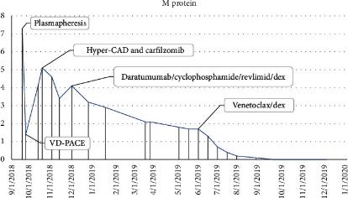
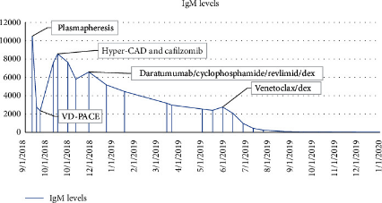
Venetoclax – promissing effects of treatemnt but still lack of prospective randomized trial
PET/CT
Bone disease before treatment
After 4 cycles of Vent-Bort-Dex
Kupsh A et al., J Oncol Pharm Pract. 2020;26(5):1274-1278.
Regimen | Time [mos] | Best response | Reson of discontinuation
VTCD | 2 | PR | PR
VRCD | 9 | CR | terapia podtrzymująca
RD - VRD | 10 | CR | PD
VRCD | 4 | SD | SD
IsaRCD | 11 | CR | PD
BCMA CAR-T | 15 | CR | PD
DRD | 2 | PD | PD
Sd | 2 | SD | SD
Veneto- dex | 7 | VGPR | VGPR
Yang Y et al., World J Clin Cases. 2021;9(5):1175-1183.
Valliani S et al. Case Rep Hematol. 2020;2020:8823877.

Slide 47
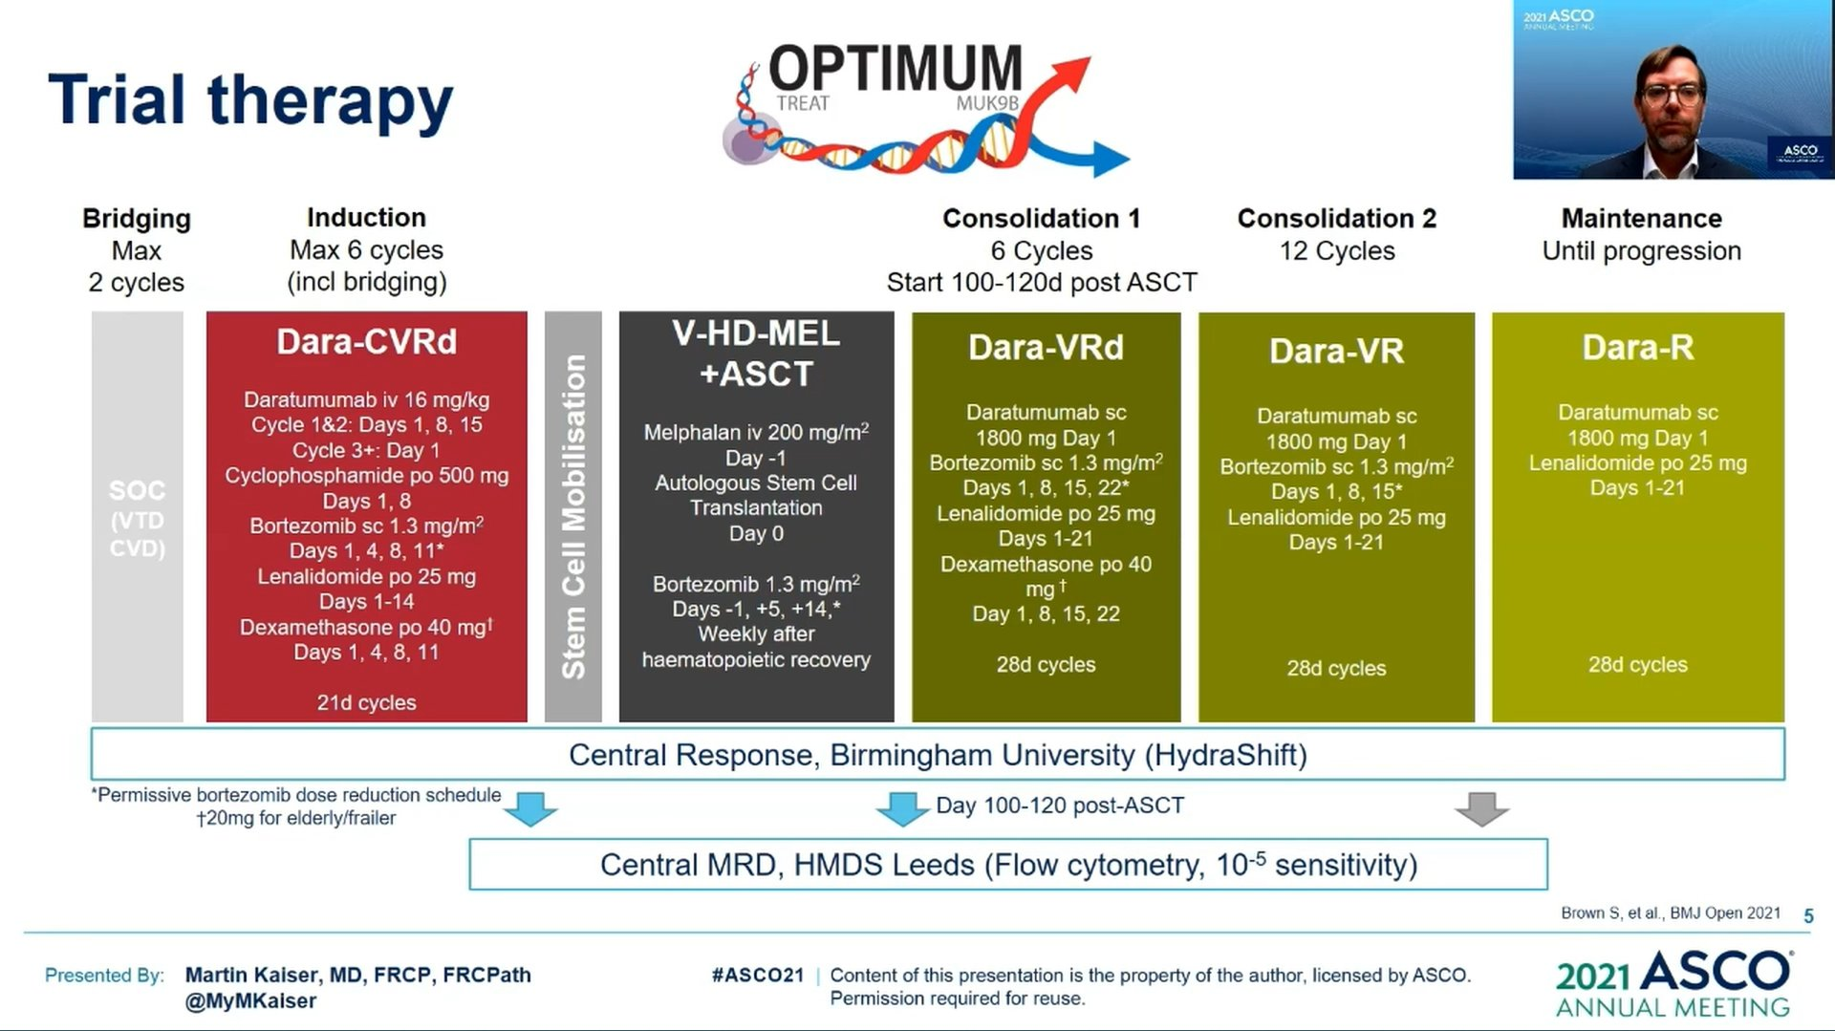

Slide 48
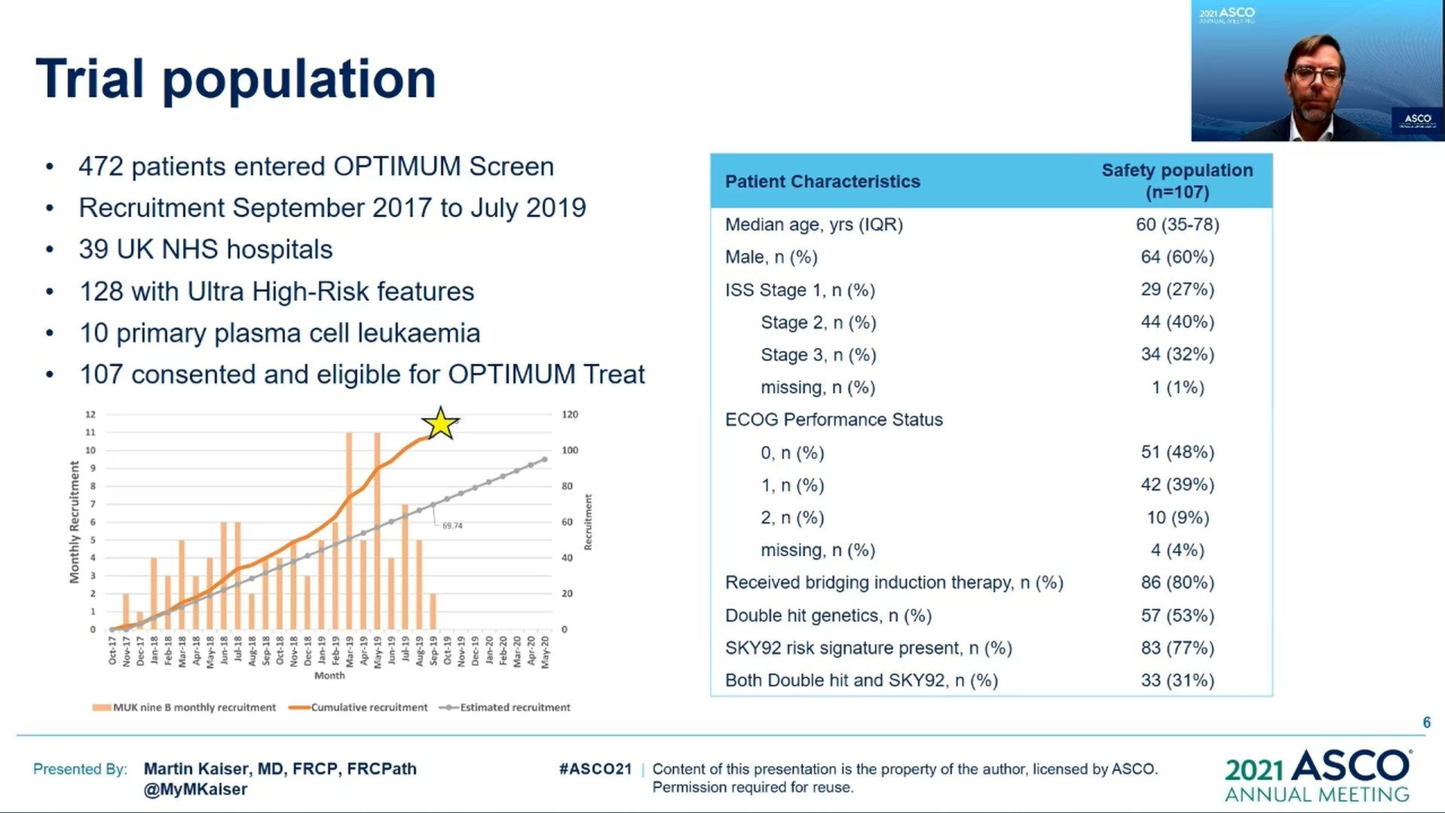

Slide 49
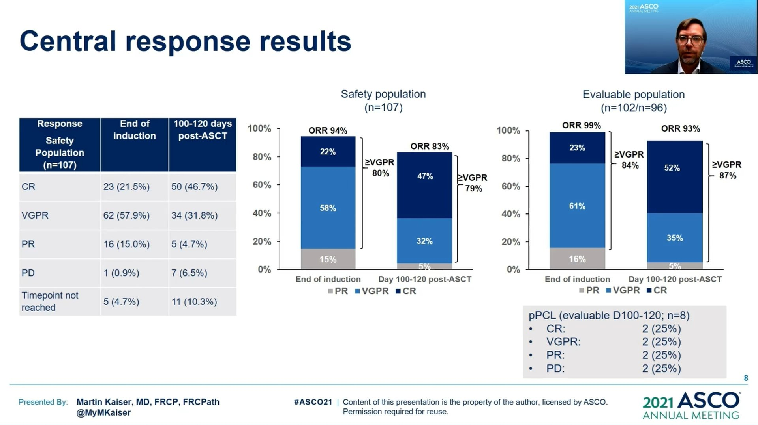

Slide 50
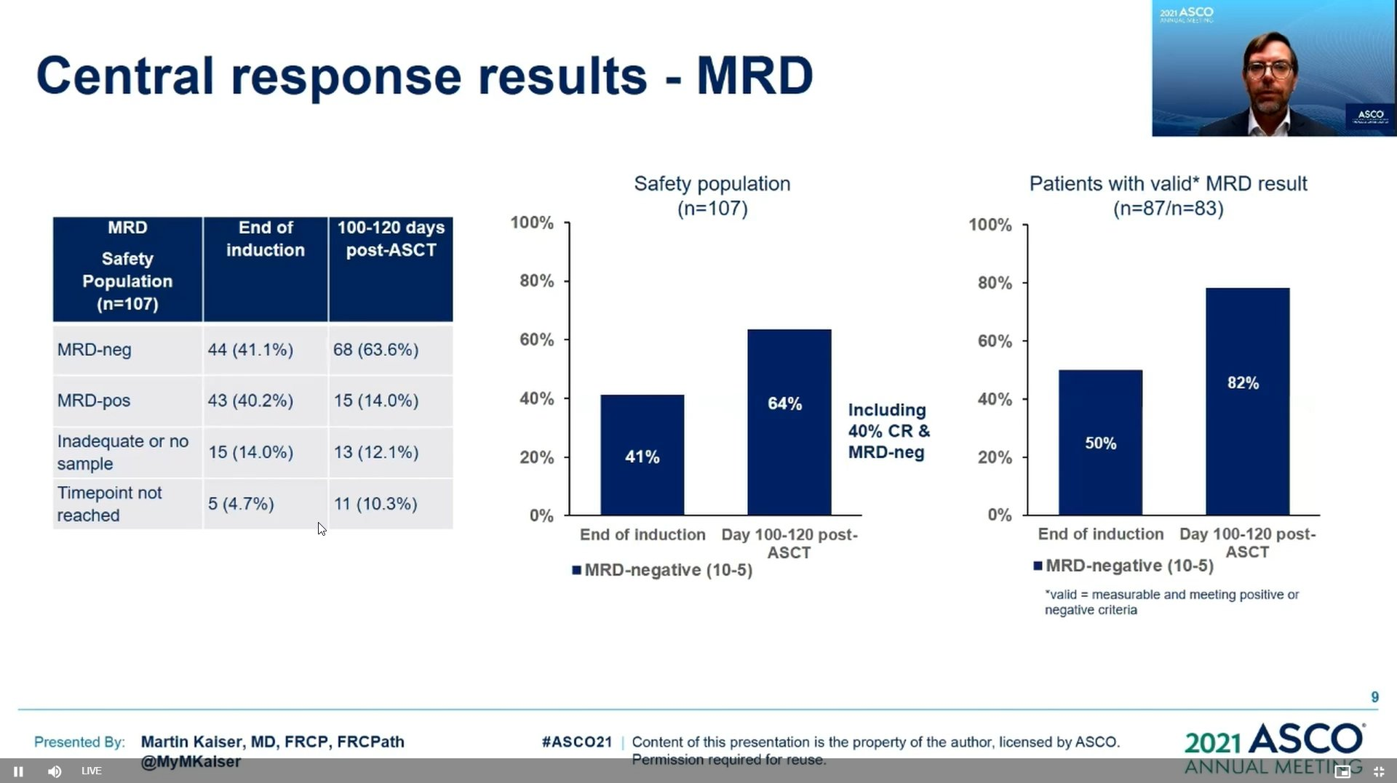

Slide 51



Slide 52
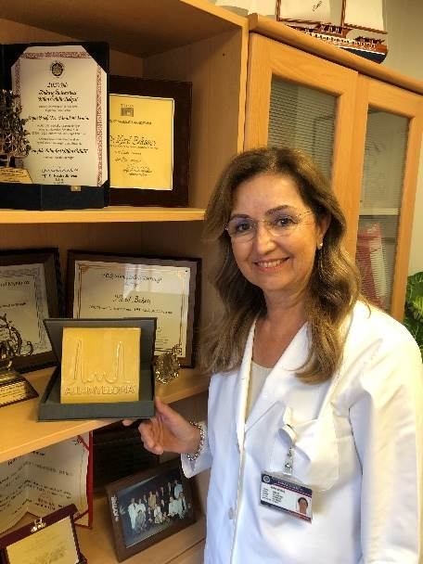
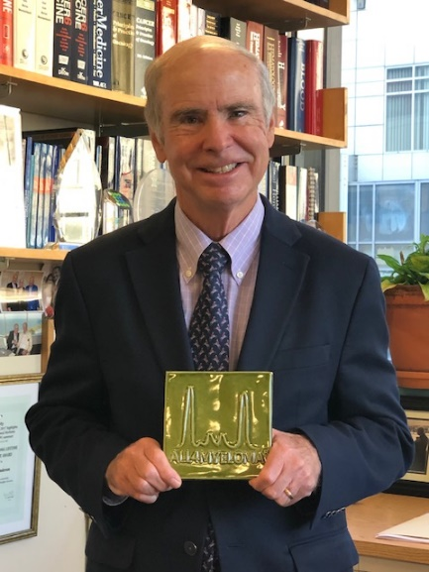
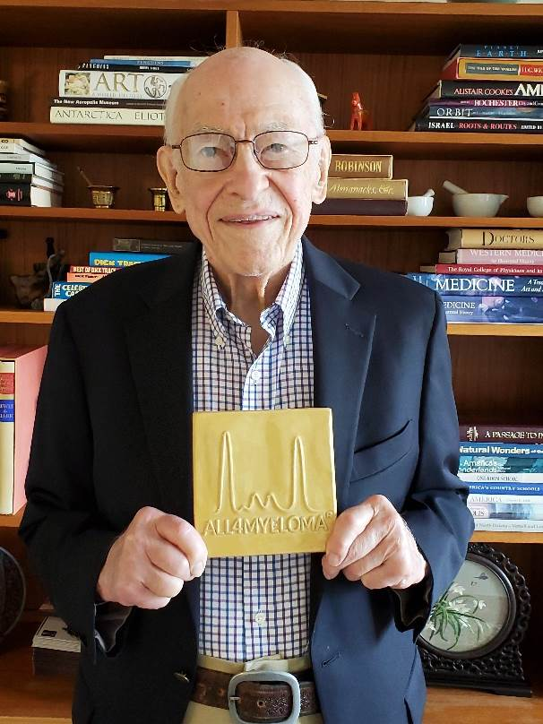
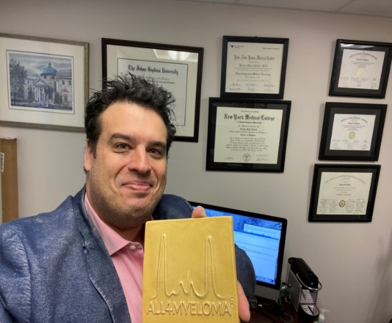
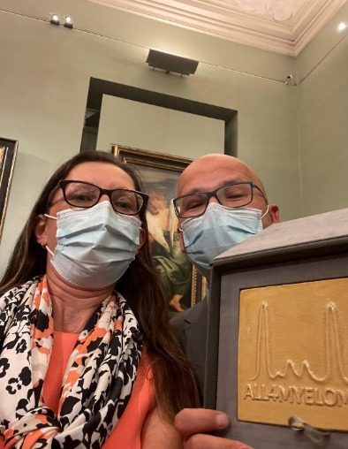
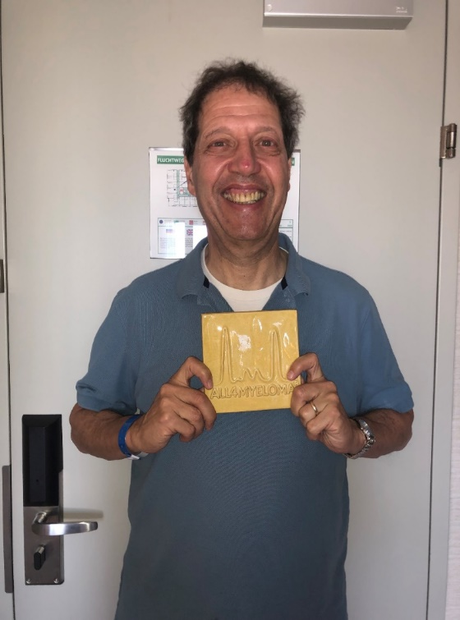
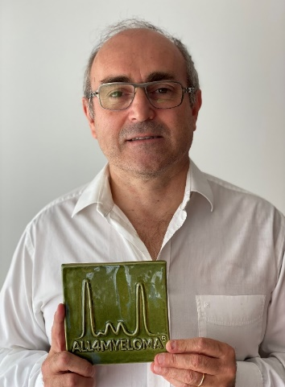
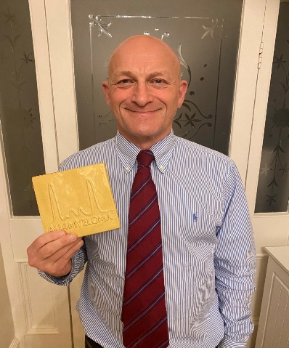

Slide 53

Thank you very much for your attention

